Slide 1
WNS I-Bot Ticket
System Issue Tracking

Slide 2

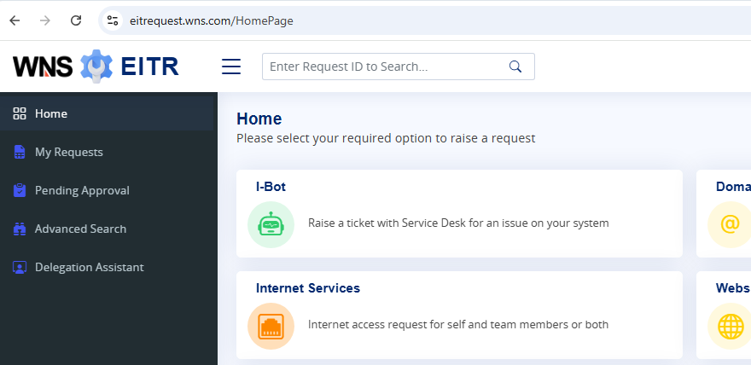
How to get the correct IBOT ticket number?
1. Go to https://eitrequest.wns.com/HomePage
2. Select My Requests (Red arrow)

Slide 3
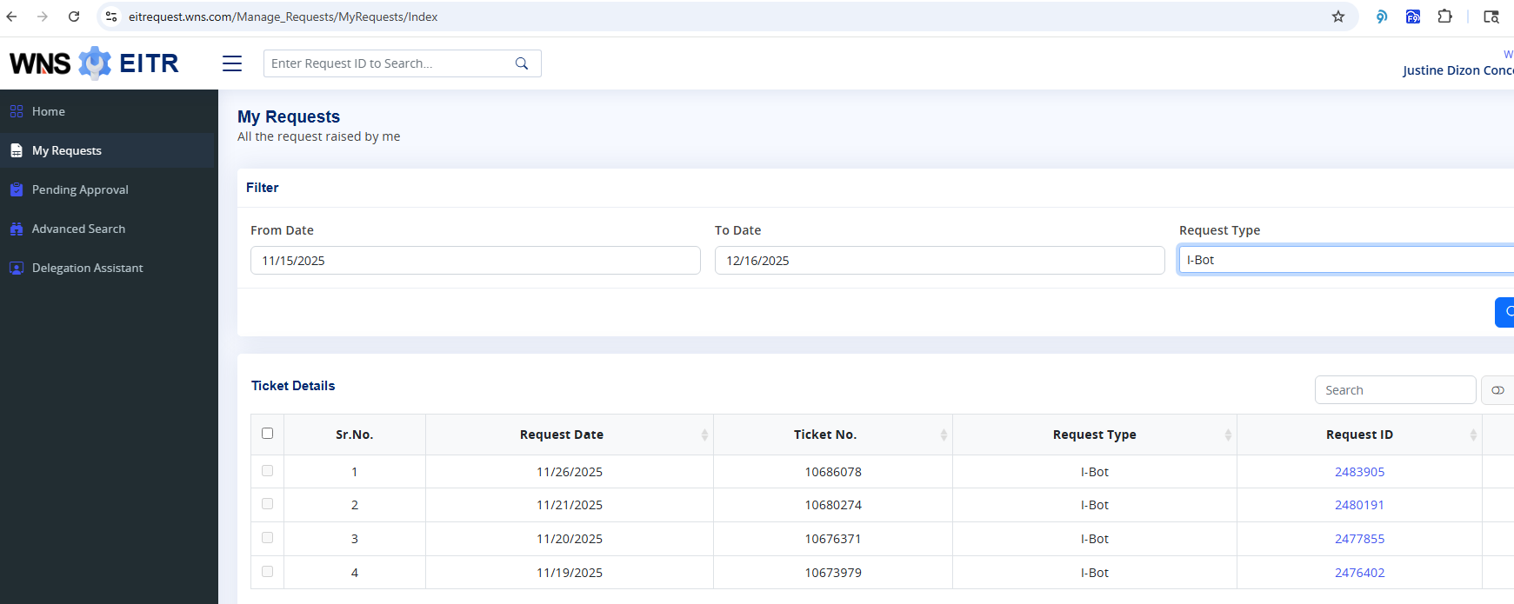
How to get the correct IBOT ticket number?
3. Go to filter “To Date” (Date should be in Manila Time)(Yellow arrow).
4. Change the “Request Type” to I-Bot (Orange arrow).
5. Click search and the latest ticket number will appear on the top. (Black arrow)

